Slide 1
Change – Plans and dreams
Basic 07 – Unit 7b

Slide 2


Hi, my name is Sean, and I would like to change some things in my life. To do that, I thought about my plans and dreams I have for the future.
For example, I’m not going to eat junk food and I want to become a member at a gym.

Slide 3
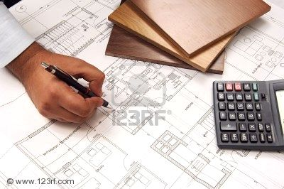
I also want to finish studying architecture, so I can become a successful architect ☺ and have my own Architect’s Studio

Slide 4
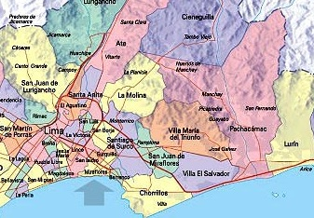


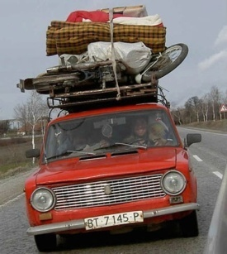
Now I am living in Surco, but I’d like to move to another district, maybe La Molina.

Slide 5

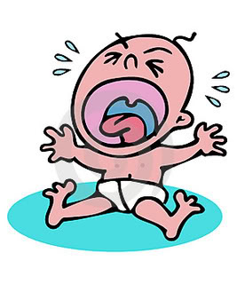
One of my goals is to buy a house, so I can get married ☺
… and eventually have a little Sean

Slide 6
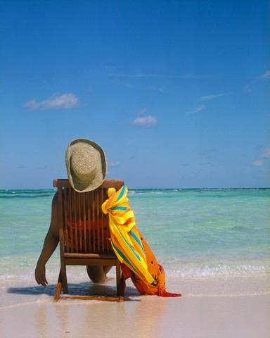

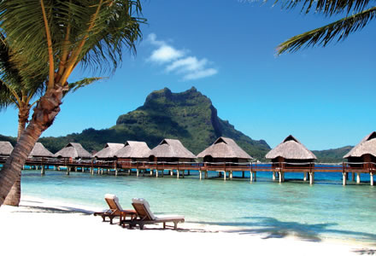
But those are my future plans and dreams. For now I’m going to take a break and relax ☺
… I’m going to take a vacation and travel to Bora Bora ☺

Slide 7
Well these are my plans and dreams
How about yours?
What are your plans and dreams?

